Slide 1
Light My Way Ministries
Psalm 119:105
Thy word is a lamp unto my feet, and a light unto my path.

Slide 2
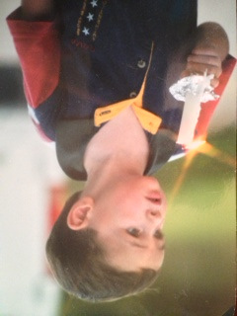
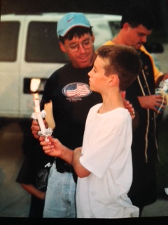
Mentoring- Teaching God’s Word to Youth as a Guide, Compass and Direction in life

Slide 3
Light My Way Ministries
Mission Statement
OUR VISION
Bless Our Families, Bless Our Community, Bless Our Future
We believe God can provide the land, the investors, the financing and the contacts for Light My Way Ministries. All is required is a dream and faith to allow God to do the miraculous. Our dream is to create a place of Faith, Family & Fellowship. It will be a blessing to our families to have a meeting place for Reunions. It will bless our community by providing mentoring to youth, Men, Women and Marriage. It would be a blessing to pass on to our future generations to carry on the vision of hope and salvation through faith in Jesus Christ.

Slide 4
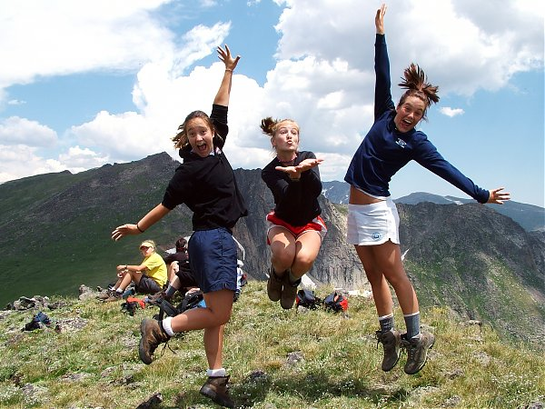


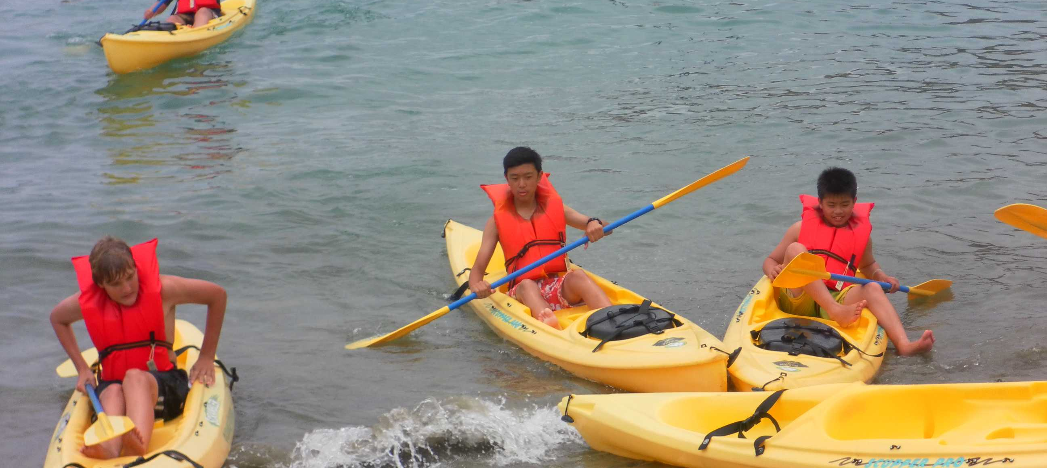
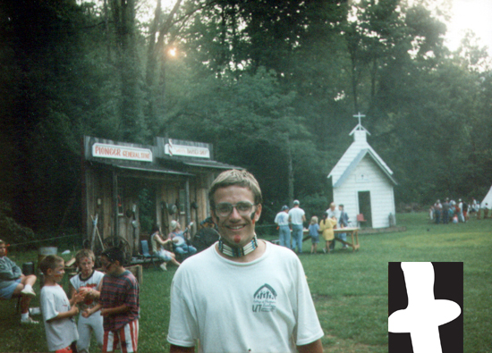
SUMMER MINI-CAMPS
Host Theme Related Youth Mini-Camps providing opportunities for Youth to grow, rededicate and receive Christ as their Lord and Savior.

Slide 5

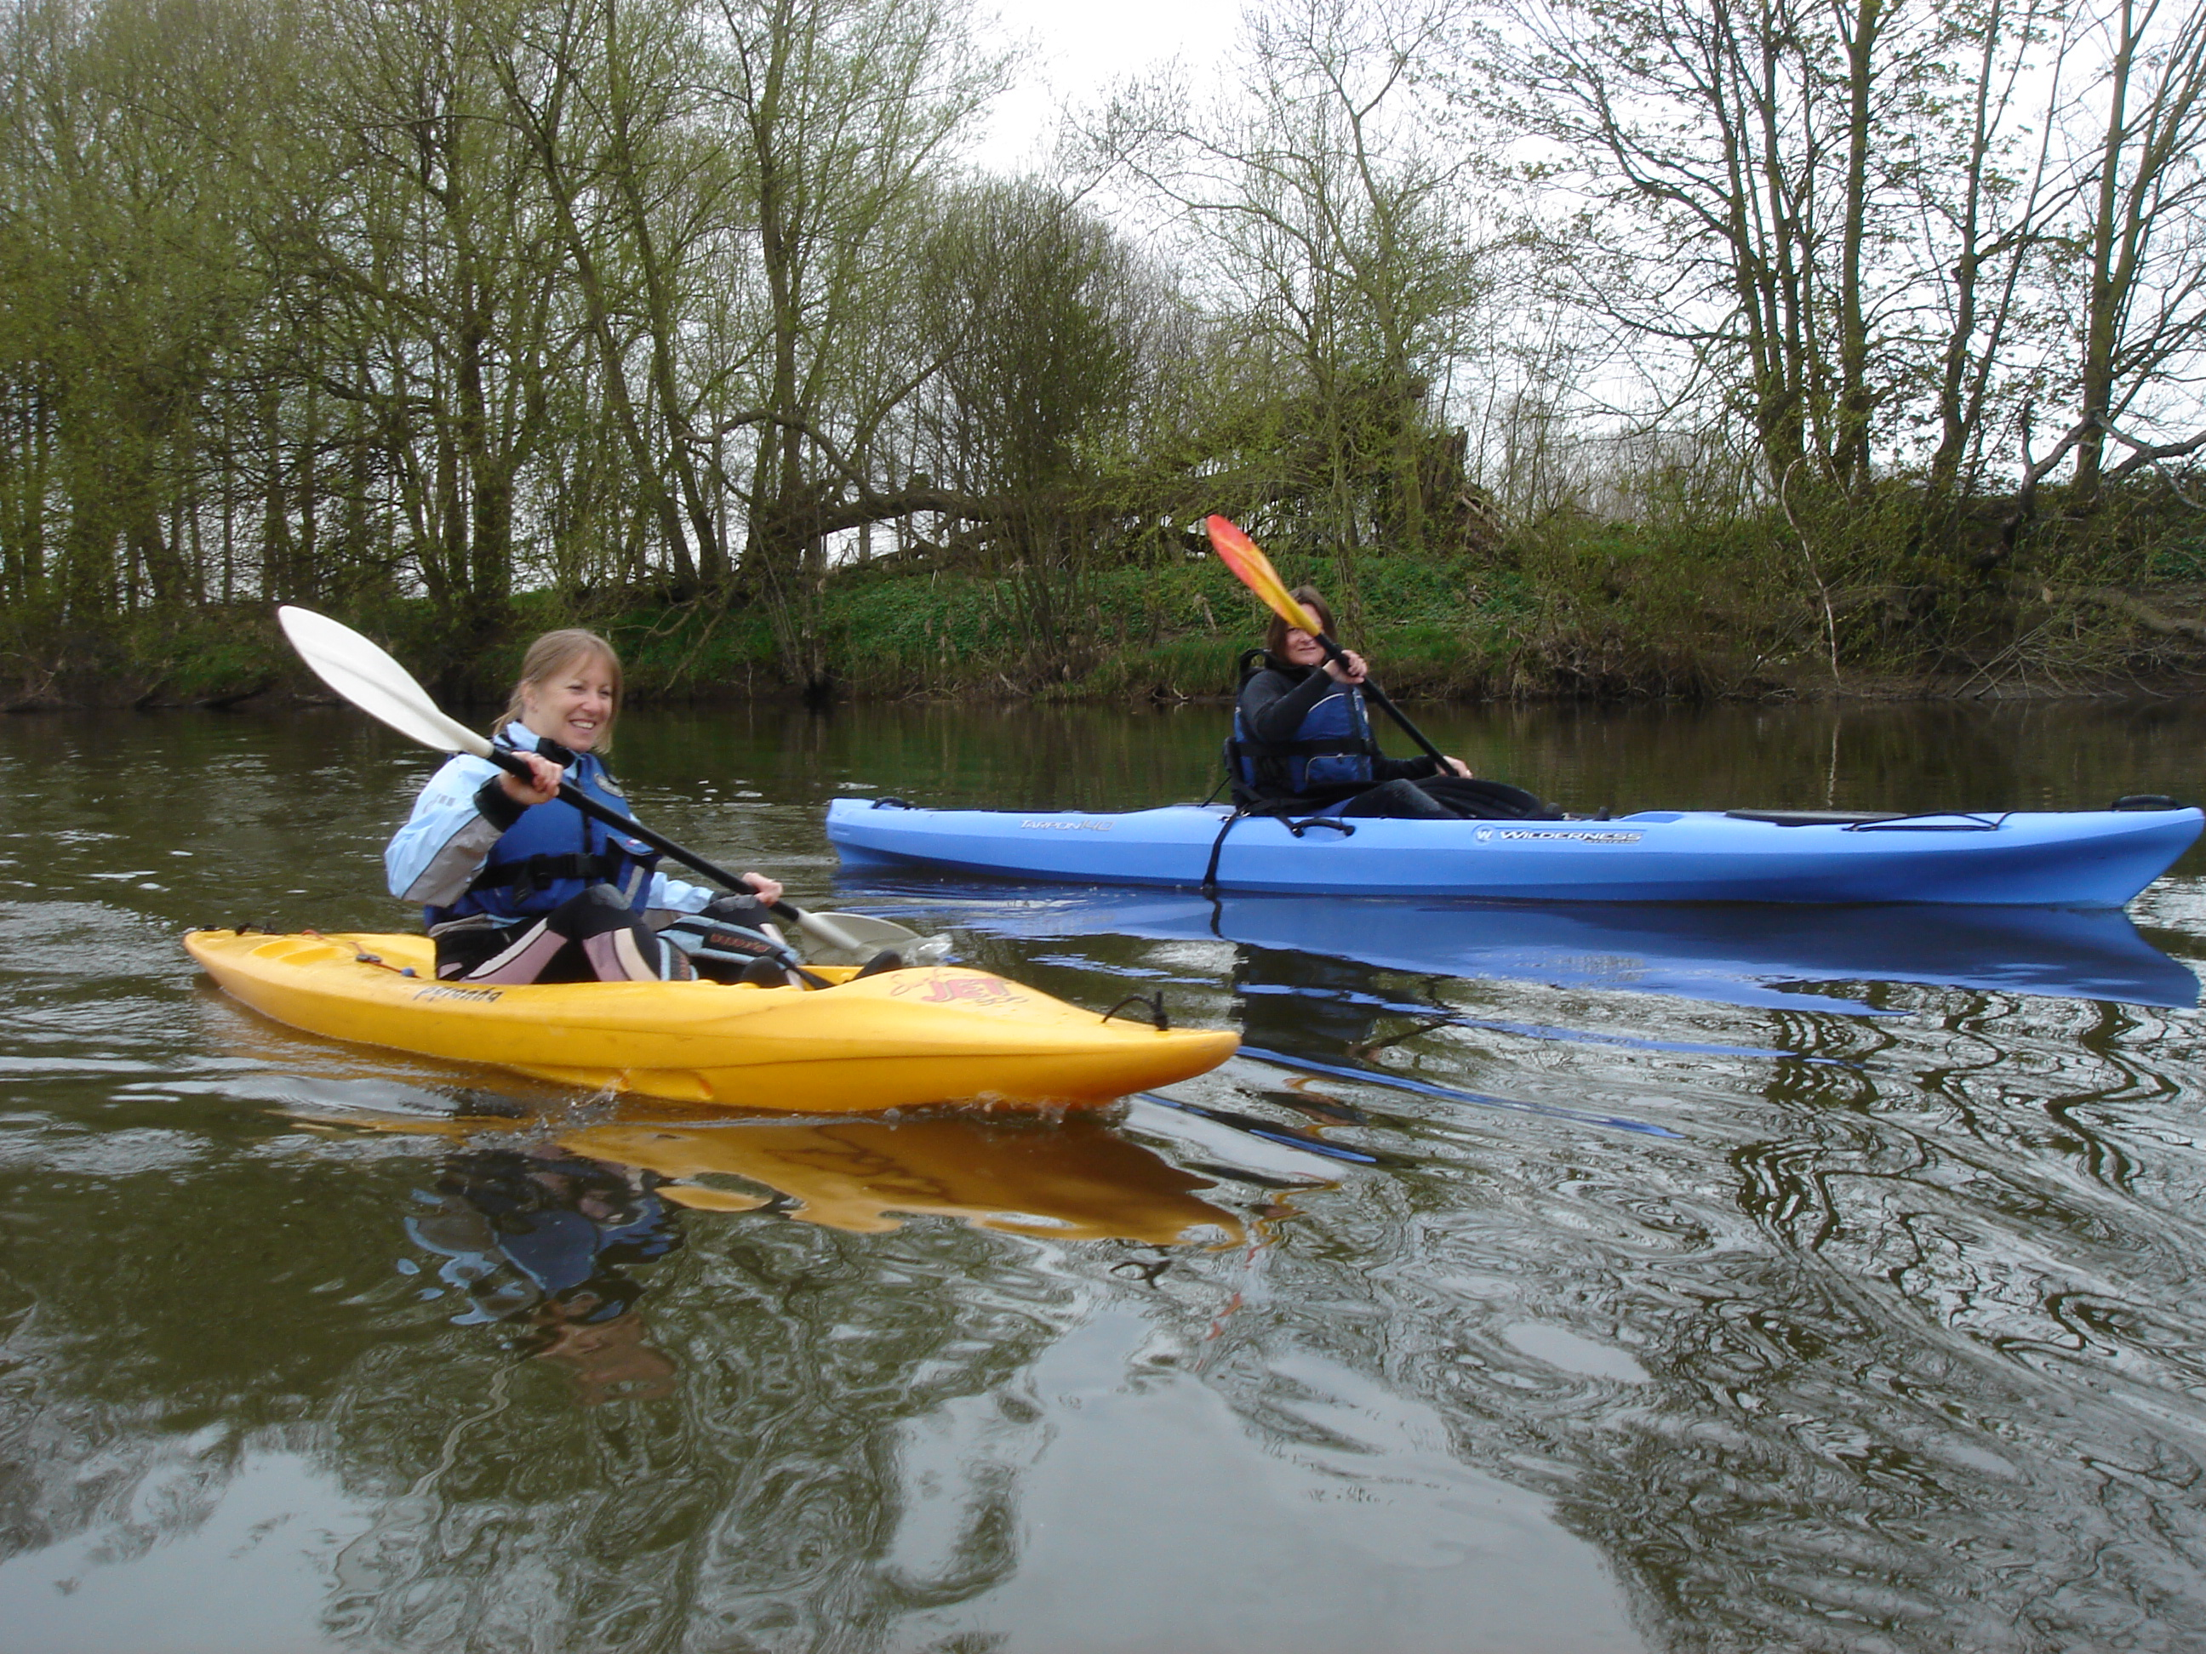
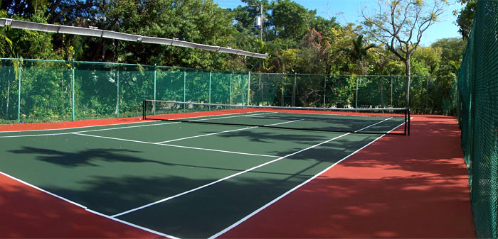
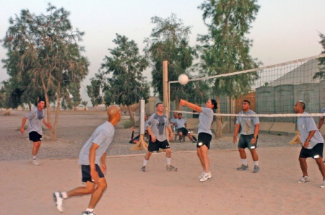
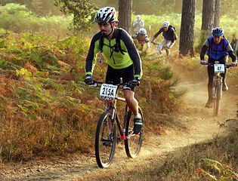
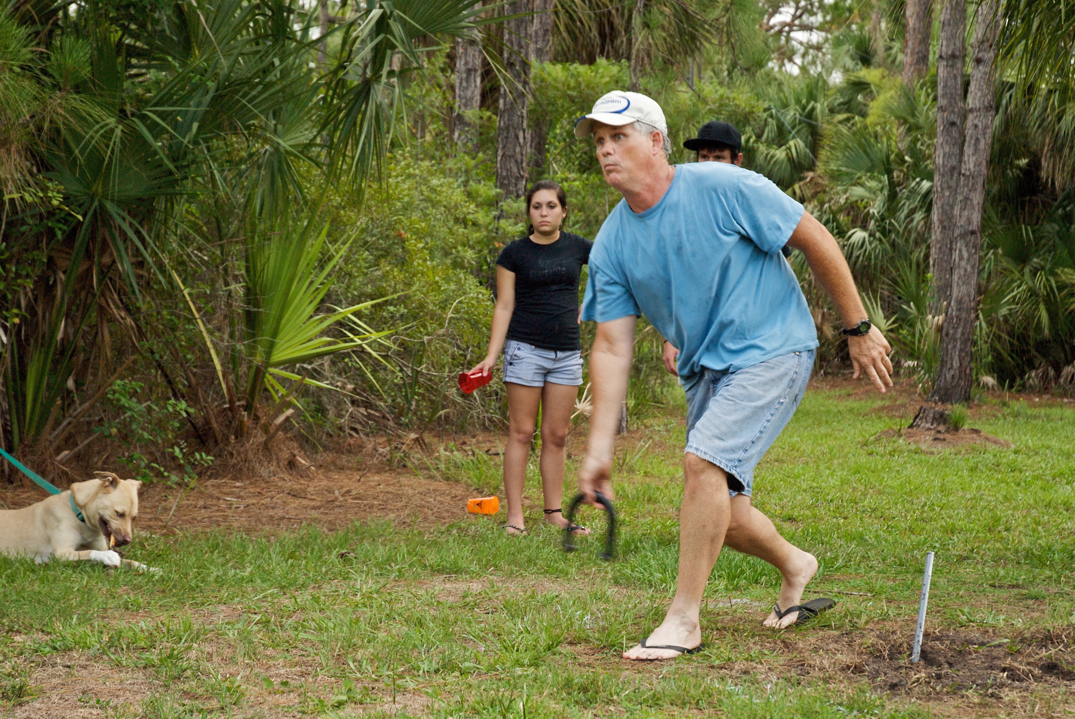
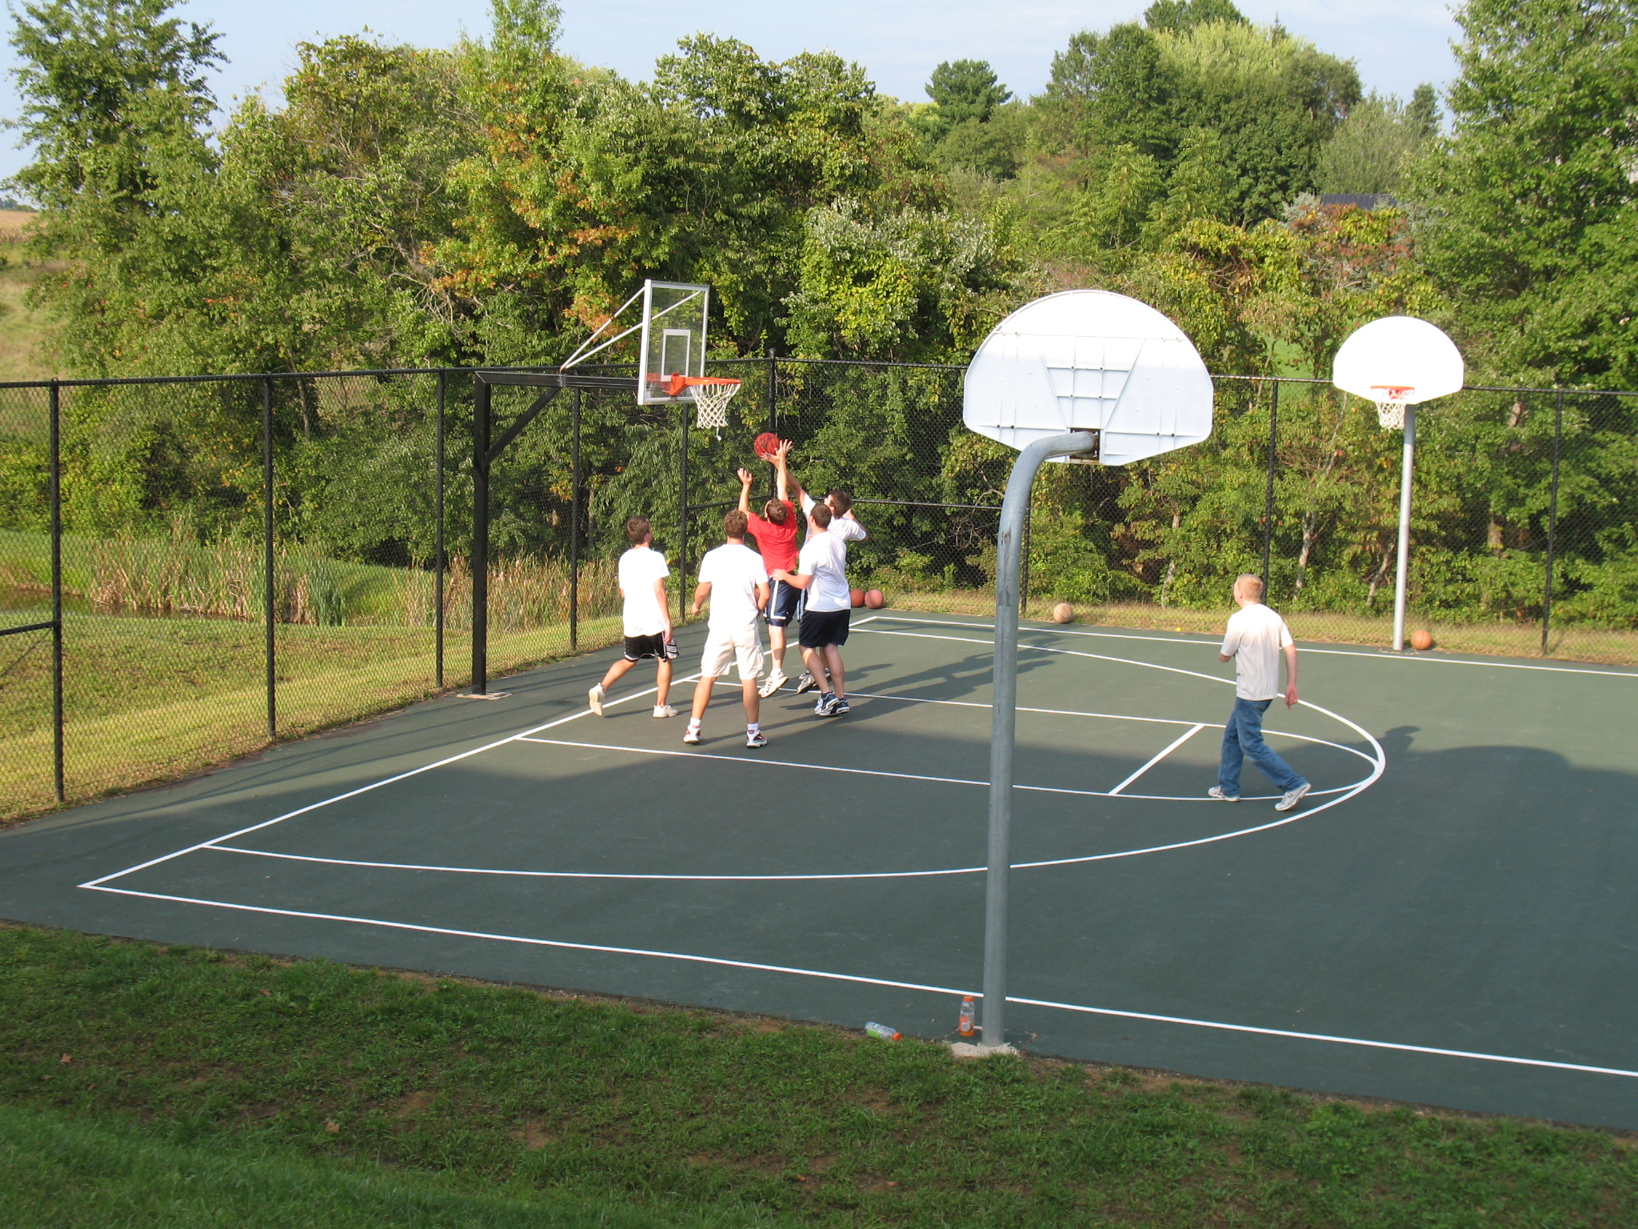
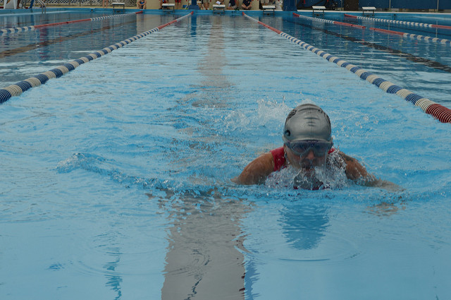
Camp Grounds
20 Cabins for Campers & Men’s Retreats
Tennis
Swimming & Triathlons
Kayaking & Mountain Biking
Horseshoes
Volleyball & Basketball Courts

Slide 6




Marriage Retreats – Refresh, Renew and Revitalize Relationships

Slide 7
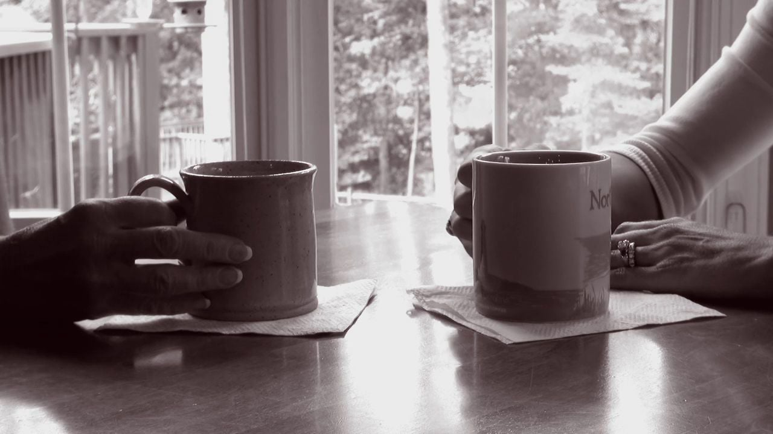
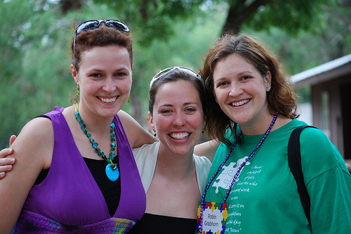
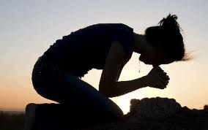

Women’s
Retreats
Allowing Women to gather to Study God’s Word to Encourage, Ignite and Empower

Slide 8
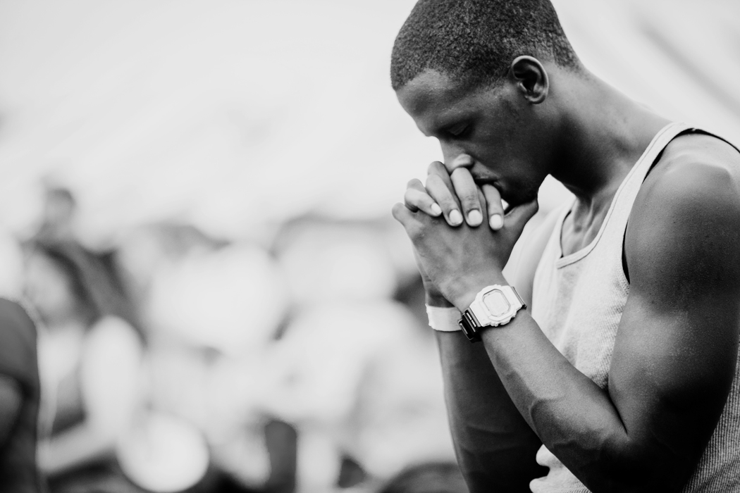
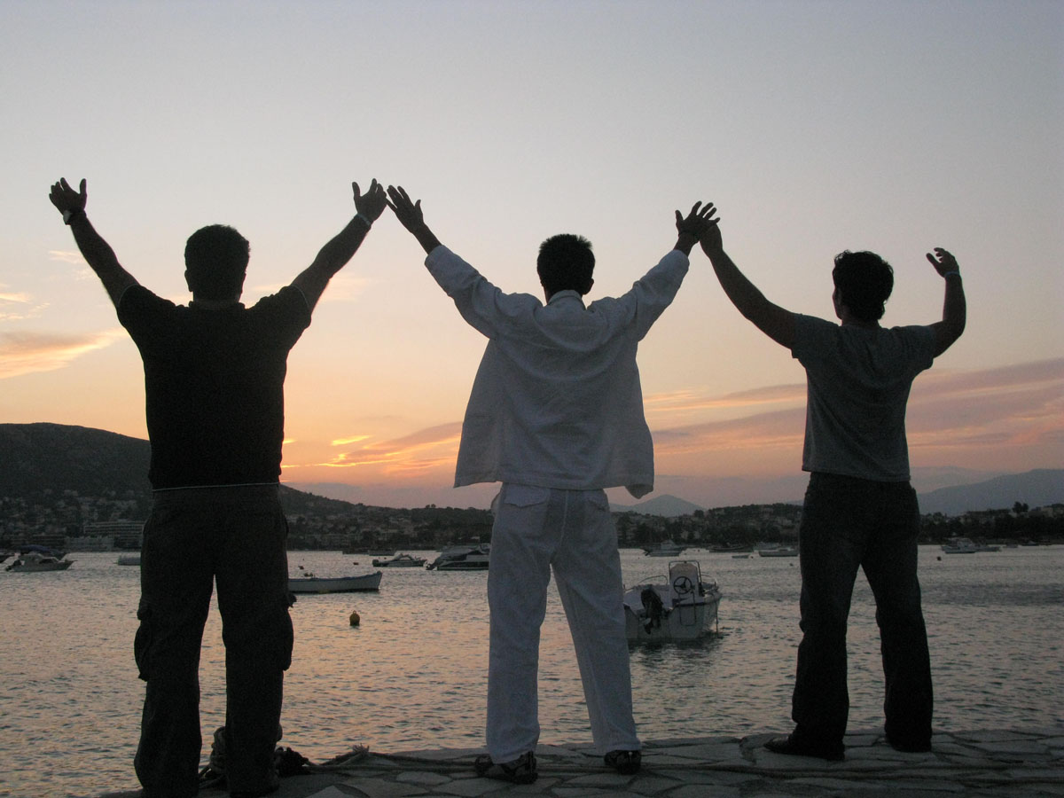


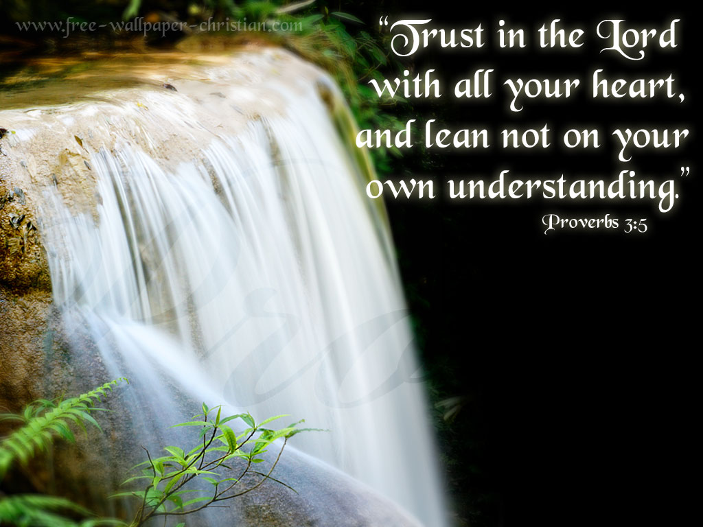
Men’s Retreats
Proverbs 27:17
“Iron sharpeneth iron; so a man sharpeneth the countenance of his friend.”
King James Version (KJV)

Slide 9
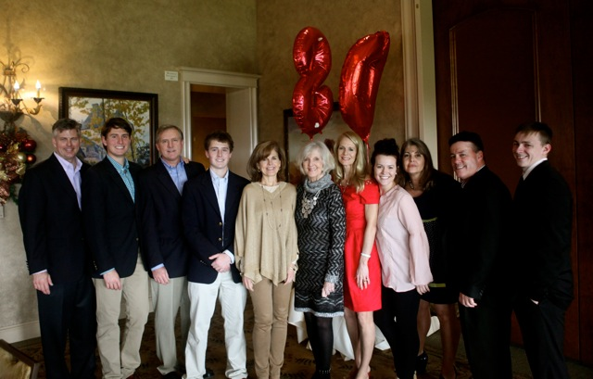

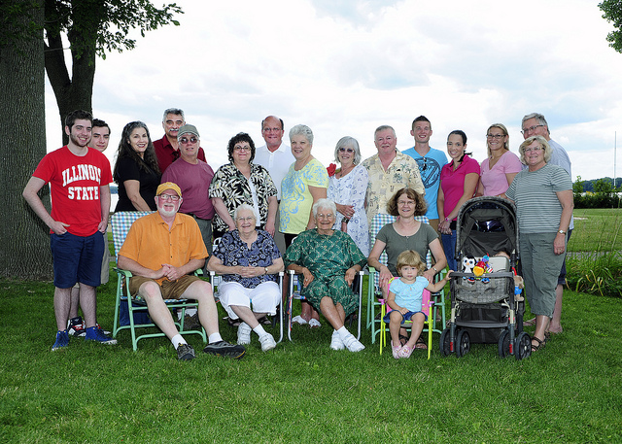
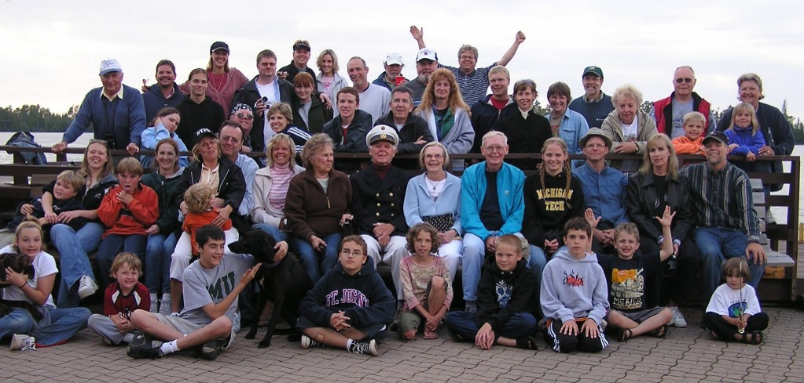

Family
Reunions
Allow Families to gather all their loved ones
in one location for fun, fellowship and time away.

Slide 10
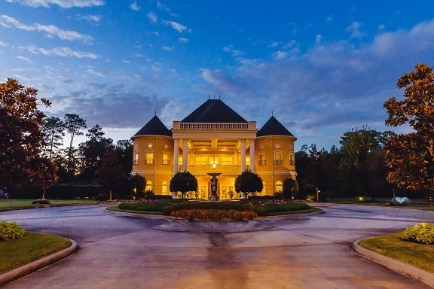
Chateau de la Luz
Weddings, Receptions, Lodging for Bridal Party & Family, Chapel, Garden Setting

Slide 11
Chateau de la Luz
Mission Statement
To provide on going income to fund and expand Light My Way Ministries
Chateau de la Luz means a “Haven of the Light”
Chateau de la Luz will be built adjoining Light My Way Ministries. The Reception Hall, Chapel, Gardens and 20 Bridal Party rooms will be used for Christian Men’s and Women’s Retreats. The yearly calendar will rotate between scheduled weddings, Family Reunions and Ministry functions.

Slide 12
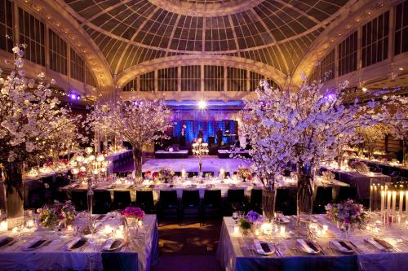
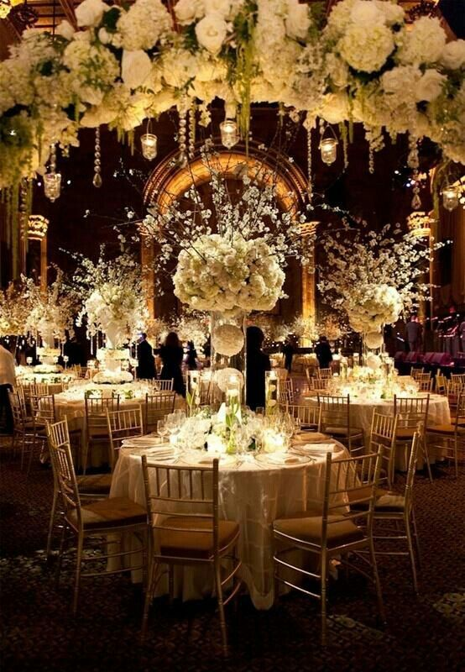
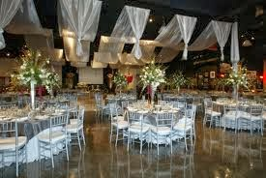
RECEPTIONS

Slide 13
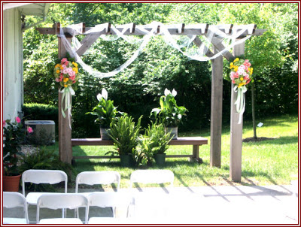
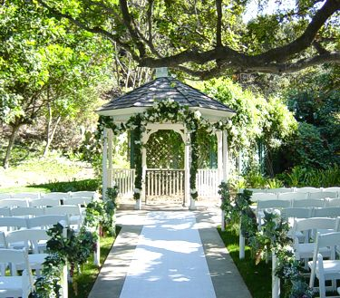
Garden Weddings

Slide 14
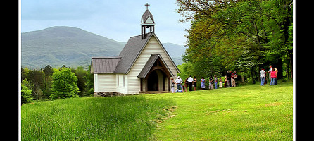
Chapel Weddings

Slide 15

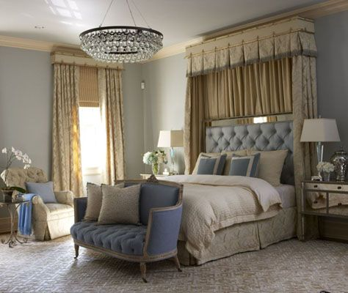


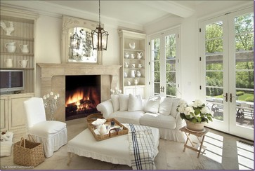

Bridal Party Rooms
20 Beautiful Rooms – Each room named to represent an attribute of our Lord
Love 11. Rest
Joy 12. Glory
Peace 13. Honor
Patience 14. Heaven
Kindness 15. Blessings
Goodness 16. Miracles
Gentleness 17. Hope
Faithfulness 18. Servant
Beauty 19. Favor
Humility 20. Praise

Slide 16
Habakkuk 2:2
Then the LORD answered me and said, "Record the vision And inscribe it on tablets, That the one who reads it may run.
The Vision for Light My Way Ministries began with the picture of my son, Cameron when he was 2 years old. Cameron was holding a candle. My neighbor, Tina Burnette (a great photographer) captured his sweet face looking intently holding the candle. I kept the picture with me. It was so dear and really brought me great joy. The other picture equally as inspirational was my husband Myles and my son, Ryan, 9 years old. Myles was giving Ryan a word of encouragement. This picture also spoke volumes.
National Day of Prayer, we gathered a group of our neighbors and friends and had a candle light service on our driveway for prayer. I found these pictures recently and God began to birth a dream for a ministry in my heart.
The Bible says, Habakkuk 2:2 "Write the Vision Down", so I put a plan together.
God uses people to accomplish his purposes. I believe one touch of God’s favor can open doors no man can shut!!!
Thanks so much!
In His Honor,
Charlotte Byrne
(832)594-7656

